Slide 1

Sync and Async
NEVER Sync to async

Slide 2
Michael Connelly
Github: P47Phoenix
GHE: Mike-Connelly
Slack: @mike.Connelly
Email: mike.Connelly@coxautoinc.com

Slide 3
What we are going to cover
The difference between the threading model in .Net Core and .Net Framework.
Why async at all?
A brief history of Asp.Net Forms
To Demos
How to implement async in ASP.NET forms.
Play around with the thread pool and break some things

Slide 4
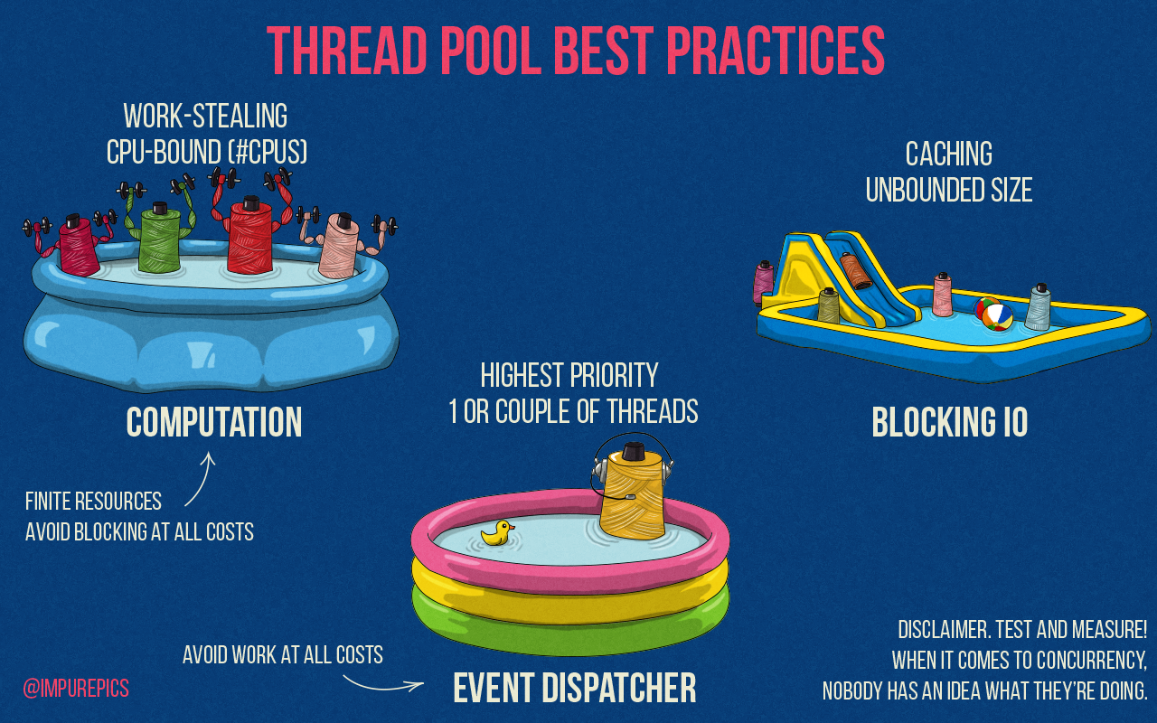
Pools of Threads

Slide 5
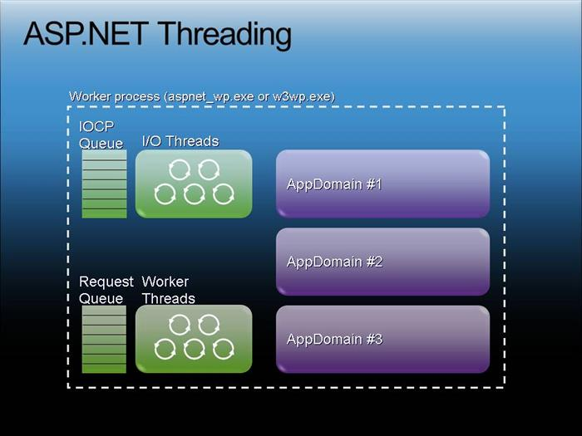
Asp.Net

Slide 6
Asp.net core is the same except for…
No Synchronization context in asp.net core
No concept of an app domain. Each asp.net core application has its own thread pool.
This means Async that works fine in core will deadlock in asp.net

Slide 7
Why Async
Well…

Slide 8
Async was originally for client code
If you ever wrote a client side app async was a god send
Async really did not by you a lot unless your really needed that extra performance, Like another 50 ms…

Slide 9
Asp.net forms
well no one will like anything you are using in 10 years either ☺

Slide 10
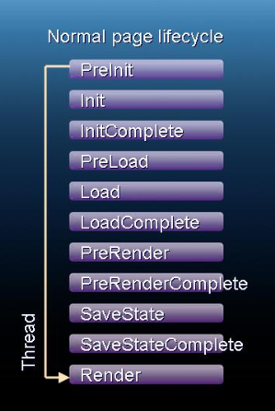
Page life cycle

Slide 11
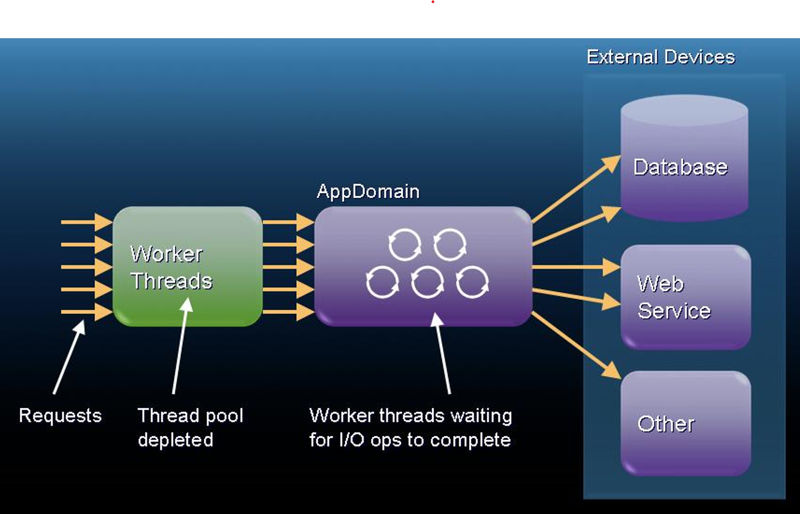
Thread pool saturation

Slide 12
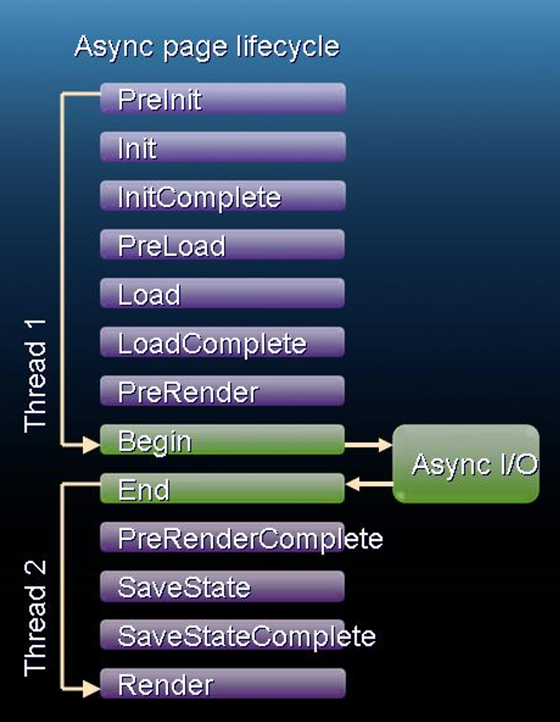
Async Page Life Cycle

Slide 13
To Demos

Slide 14
Where to find this code
https://github.com/P47Phoenix/AsyncBestPractices
This slide deck is there as well.
http://www.williablog.net/williablog/?tag=/scalability
https://docs.microsoft.com/en-us/aspnet/web-forms/overview/performance-and-caching/using-asynchronous-methods-in-aspnet-45
https://docs.microsoft.com/en-us/visualstudio/code-quality/install-fxcop-analyzers?view=vs-2019

